Slide 1
Yelp Ratings System on Steroids
XiuXiang Jin
YuHao Liu
Ammar Karim
Zeqiang Lin
Notes:
Sentiment-Classifications of Restaurant Review

Slide 2
Introduction
Primary motivation
Overview of the system
Why did we switch?
Notes:
an overview of your system with possible changes made from your specification

Slide 3
Background
Sentiment extraction method used and steps taken by others:
Use Yelp released dataset and manually annotate reviews into 5 categories.
Create binary features for rating 1-2 stars, 3 stars, and 4-5 stars and textual features of individual words, bigrams and trigrams.
Create 5 binary classifiers by transform into 5 different dataset for each category to avoid correlation among categories.
Use SVM to treat each category separately to do a final prediction.
Notes:
Categories - food, ambience, service, deals, and worthiness.
Review stars 1-2 = bad, 3 = moderate , 4-5 = good
SVM - support-vector machines

Slide 4
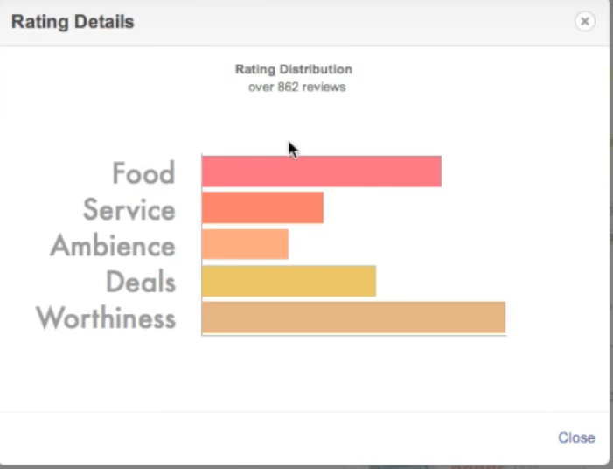
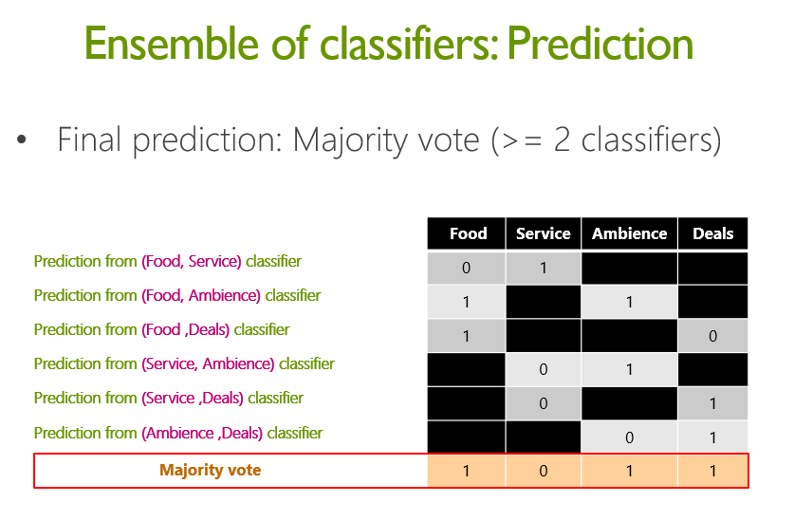
Background (Cont’)

Slide 5
Organization
XiuXiang Jin: Background Research and Methodologies Analysis
YuHao Liu: NLP: Keyword Extraction
Ammar Karim: Data extraction/structuring, architecture, front-end design
Zeqiang Lin: Classifier
Notes:
How your team will develop this system: team organization, data collection and study, algorithms and data structures of your system, systems/libraries to be used

Slide 6
Key Extraction
The Three Main Components for Key Extraction:
Candidate Selection
Properties Calculation
Scoring and Selecting Keyword
Formula: Python using RAKE
Machine Learning: Java with Maui
Toolkit: Weka

Slide 7
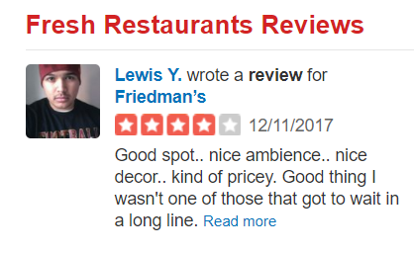
Example

Slide 8
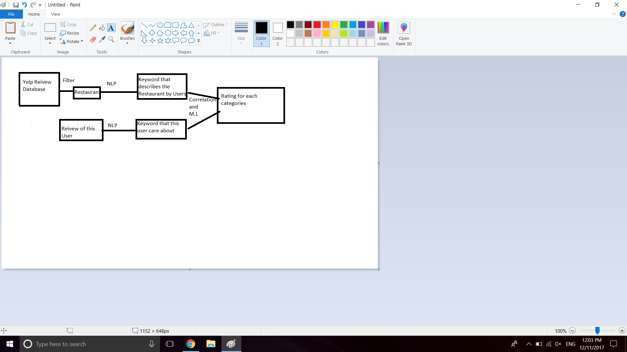
System
Notes:
Preliminary data and prototype of your system, e.g., GUI and initial data visualization/analysis, that your team has already conducted

Slide 9
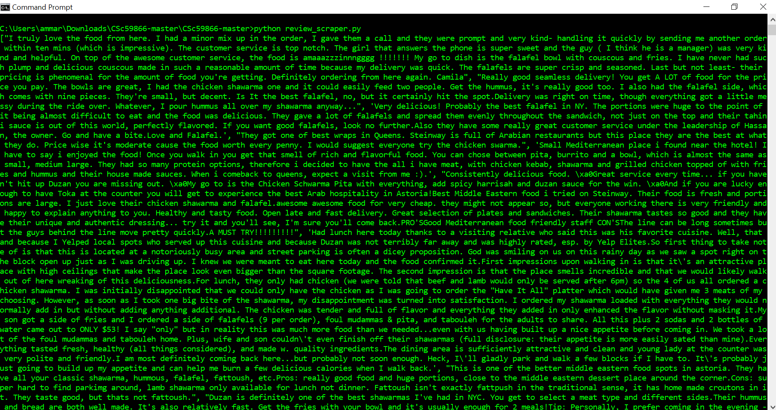
Grab Reviews
https://github.com/zlin001/CSc59866/blob/master/review_scraper.py

Slide 10
Conclusion
Our prediction is mostly based on user's reviews. By now, we separate the user’s reviews into 5 categories to give user recommendation more accurately. The output of our system for now is the rating for each categories. We can add more features to make it more useful, such as let user choose different type of meal and we provide them rating based on their input.
Notes:
Concluding remarks: bottom-line results of your system; potential problems and corresponding solution strategies.

Slide 11
References
Medelyan, Alyona. NLP keyword extraction tutorial with RAKE and Maui.
https://www.airpair.com/nlp/keyword-extraction-tutorial
Sajnani, Hitesh, et al. “Yelp Dataset Challenge.” The Yelp Dataset Challenge - Multilabel Classification of Yelp Reviews into Relevant Categories, www.ics.uci.edu/~vpsaini/.
“The Best of Yelp.” Yelp, www.yelp.com/c/manhattan/restaurants.
https://www.yelp.com/c/manhattan/restaurants
Notes:
http://www.cnblogs.com/arkenstone/p/6064196.ht

